Slide 1
Migrazione DocSolutions for File System EOI (Eos Internal)
13 Gen 2021
Andrea Di Ceglie

Slide 2
Overview
Moving from C/AL implementation of DocSolutions for Sharpoint requires data and file migration. Legacy implementation are based on metadata used as foreign key:
DSNavKey
DSDocType
DSCompany
New Sharepoint storage is based on Folder and subFolder.
To migrate from legacy DocSolutions to New Docsolutions the suggested path is.
Move files from Sharepoint to a local FileSystem
Upload to the new Sharepoint using the Standard Microsoft Sharepoint migration tool (https://docs.microsoft.com/it-it/sharepointmigration/introducing-the-sharepoint-migration-tool )
Setup DocSolutions according to new Sharepoint Location
To Perform Step 1:
A) InstallDocSolutions C/AL
B) Setup both Sharepoint Path and FileSystem Path at the same time
C) Run the migration program (https://github.com/EOS-Solutions/Sample )
D) Remove legacy Setup

Slide 3
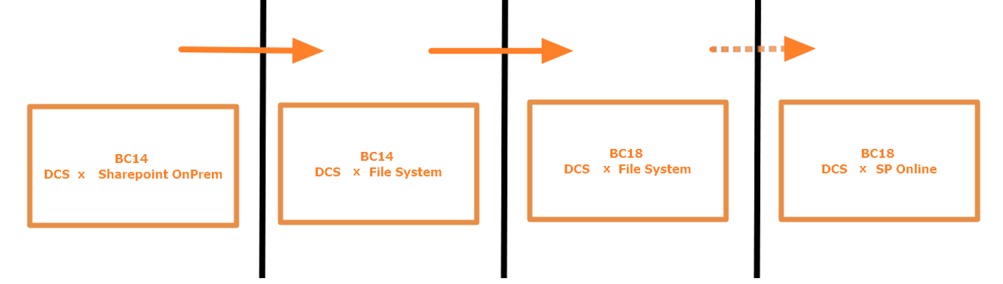
Suggested Migration path when moving from NAV to BC

Slide 4
Overview
To Perform Step 2:
Install Microsoft Sharepoint Migration tool
Follow Instruction https://docs.microsoft.com/en-us/sharepointmigration/how-to-use-the-sharepoint-migration-tool . Use a CSV file to set the local file system and New Sharepoint OnLine location
Migrating data files from a local file share
Start SPMT, and then enter your Microsoft 365 username and password.
Select Start your first migration.
Select File Share.
Enter the source path of the file share where your content is located, and then select Next.
Enter the URL of the SharePoint site where you want your files migrated, and then select Next.
Note
If you have already signed in to that site once while using this tool, you won't be prompted again for the same site.
Select the document library to where your files will be copied, and then select Next.
This task is added to the list. If you want to select another set of data files to migrate, select Add another source.
When you have finished selecting your sources, select Next.
Review your settings, and then select Migrate.

Slide 5
Current Setup Sharepoint (sample)
STATUS | ID TABELLA | TIPO OPTION TABELLA | COD. TIPO DOCUMENTO | TIPO STORAGE | URL STORAGE | COD. LIBRERIA DEFAULT
Certificata | 17 | 0 | CONTABILI | Sharepoint | http://<yourServer>.eos.it/admin | CONT
Certificata | 18 | 0 | CUSTOMER | Sharepoint | http://<yourServer>.eos.it/admin/vendite | ACCORDI
Certificata | 23 | 0 | VENDOR | Sharepoint | http://<yourServer>.eos.it/admin/acquisti | ACQ
Certificata | 36 | 1 | SALESORD | Sharepoint | http://<yourServer>.eos.it/admin/vendite | VEN
Certificata | 36 | 2 | SALESINV | Sharepoint | http://<yourServer>.eos.it/admin/vendite | VEN
Certificata | 36 | 3 | SALESINV | Sharepoint | http://<yourServer>.eos.it/admin/vendite | VEN
Certificata | 38 | 0 | PURQUOTE | Sharepoint | http://<yourServer>.eos.it/admin/acquisti | ACQ
Certificata | 38 | 1 | PURORDER | Sharepoint | http://<yourServer>.eos.it/admin/acquisti | ACQ
Certificata | 38 | 2 | PURCHINV | Sharepoint | http://<yourServer>.eos.it/admin/acquisti | ACQ
Certificata | 112 | 0 | SALESINV | Sharepoint | http://<yourServer>.eos.it/admin/vendite | VEN
Certificata | 114 | 0 | SALESCR | Sharepoint | http://<yourServer>.eos.it/admin/vendite | VEN
Certificata | 122 | 0 | PURCHINV | Sharepoint | http://<yourServer>.eos.it/admin/acquisti | ACQ
Certificata | 124 | 0 | PURCHCR | Sharepoint | http://<yourServer>.eos.it/admin/acquisti | ACQ
Certificata | 167 | 0 | JOB | Sharepoint | http://<yourServer>.eos.it/admin/vendite | ACCORDI
Certificata | 5600 | 0 | FA | Sharepoint | https://<yourServer>.eos-solutions.it/admin | CESPITE
Certificata | 18123250 | 0 | PRQ | Sharepoint | http://<yourServer>.eos.it/admin/acquisti | RDA
Certificata | 18123252 | 0 | PRQ | Sharepoint | http://<yourServer>.eos.it/admin/acquisti | RDA

Slide 6
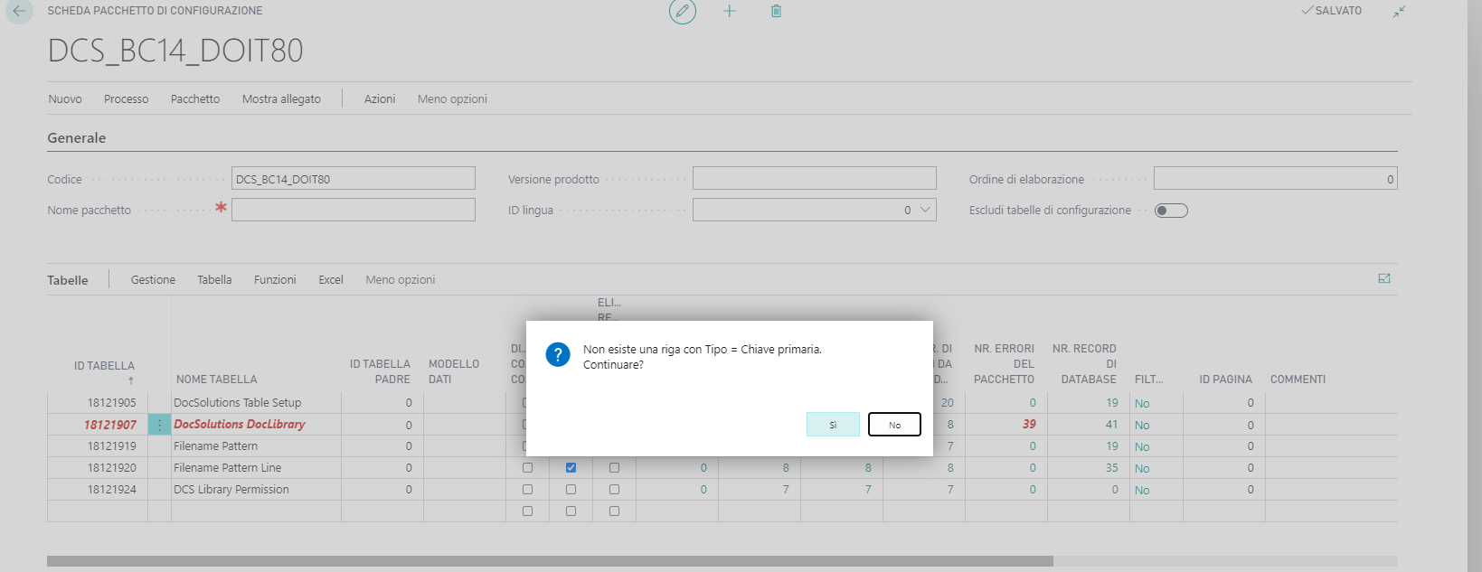
RapidStart Import
Import Package forcing some values
On Message : «A record with type» /«Non esiste una riga con tipo=…. Click «Yes» (once for each record)
On Message : «Warning! At least one record has type» / «Attenzione! C'è almeno una riga con Tipo = 'Campo'. Se il valore di questo campo….» …. Click «YES»
18121920 Filename Pattern Line: SET Ignore table trigger=True

Slide 7
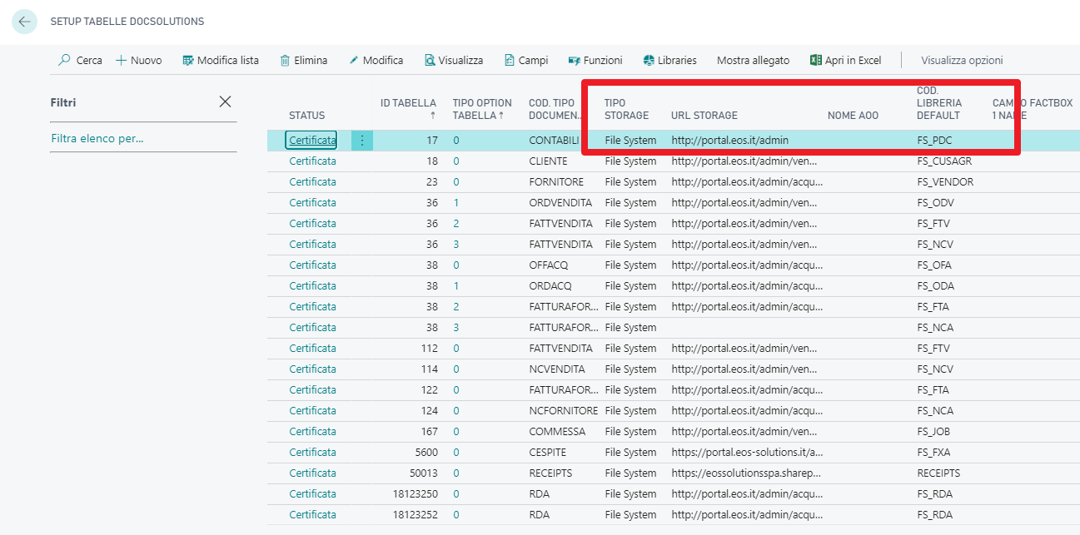
Rapid Start: dopo import
After importing Rapid Start data should be set:
Storage type: File System
Storage URL : compiled and valid
Default Library: File System

Slide 8
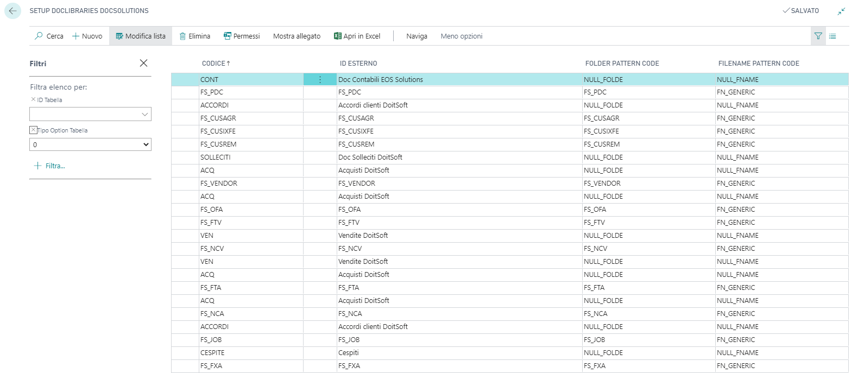
Libraries
Al libraries are duplicated. Must exist at the same time the legacy library for Sharepoint and the new library for FileSystem
Use a strong Naming Conventions such as: NULL_FOLDE e NULL_FNAME for placeholder that must be skipped

Slide 9
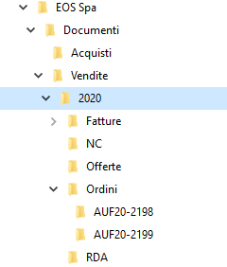
Suggested Folder tree
Documents (allo docs with consistent and equal setup)
Company/Documents/Sales/Year/DocType/DocNo

Slide 10
Step 1
Block new uploads on Sharepoint (Set Read Only)
Load RapidStart with new DocSolutionsSetup
Run migration program that moves files from SP to filesystem
Delete legacy DocSolutions setups that refer to Sharepoint
Set Permission set in Business Central
Certify new setups

Slide 11
CheckList
What | Who | When | output
Define a network Shared drive | IT |  | \\serverName\DocSolutions
Network drive security | IT |  | Gruppi AD ?
Network drivebackup | IT |  | Backup policy ?
DocSolutions Setups | Consultant |  | RapidStart
DocSolutions permission | Consultant |  | Permissions are set
Run File migration on a test env | Developer |  | Files are copied to Network drive
Block upload on Sharepoint | IT |  | SP is read only
Run File migration on Production env | Developer |  | Files are copied to Network drive
Delete legacy setup | Consultant |  | Comunicazione interessati

Slide 12

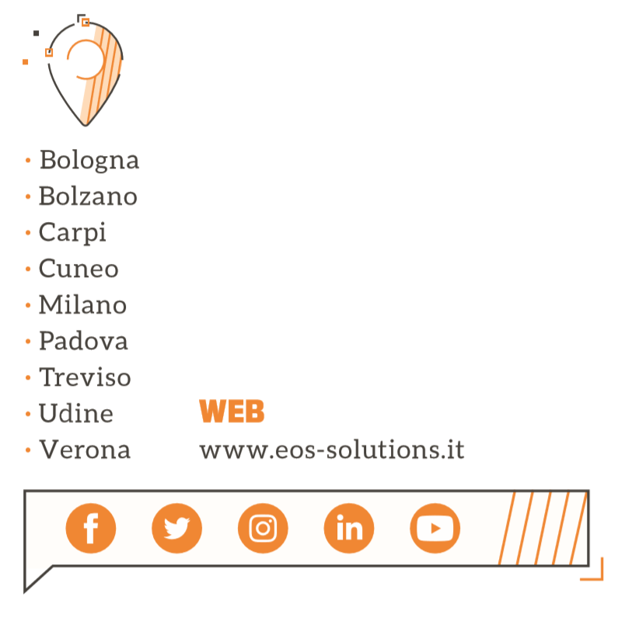

Grazie!

